Slide 1
Weekly Meeting
Nov 29, 2021
Gwangwoo Kim

Slide 2
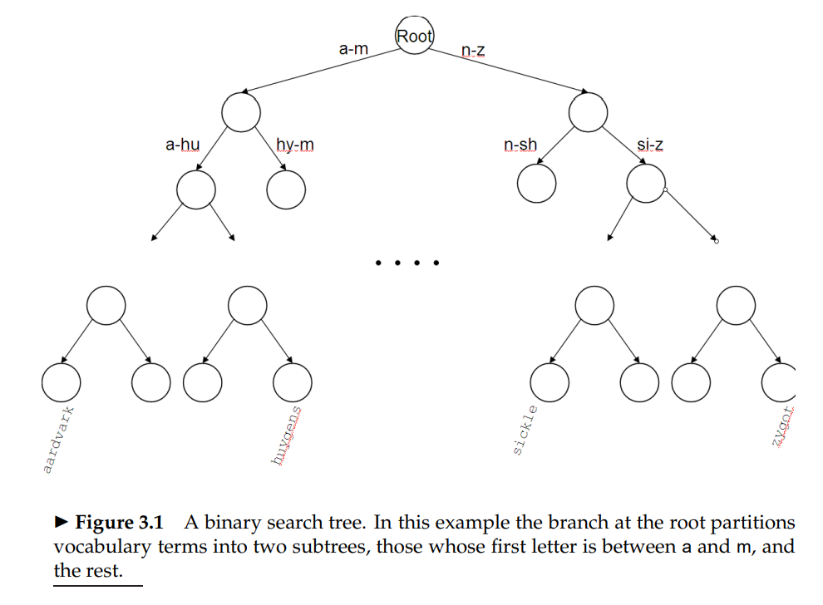
3.1 Search structures for dictionaries

Slide 3
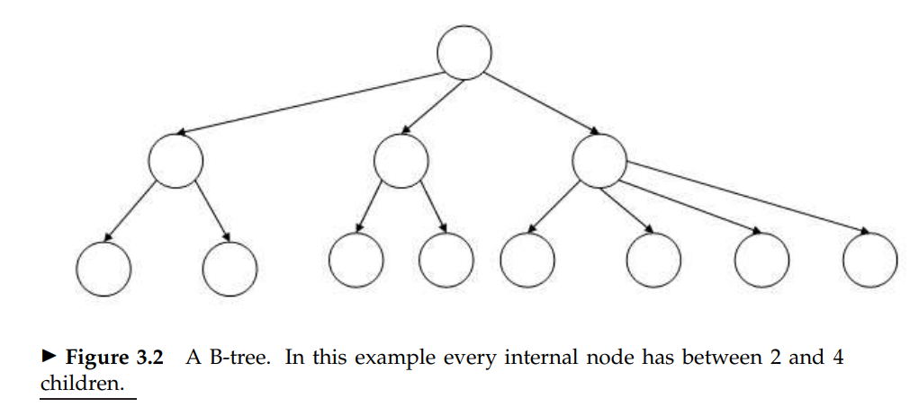
3.1 Search structures for dictionaries

Slide 4
3.2 Wildcard queries
The user is uncertain of the spelling of a query term (e.g., Sydney vs. Sidney)
The user is aware of multiple variants of spelling a term and (consciously) seeks documents containing any of the variants (e.g., color vs. colour)
The user seeks documents containing variants of a term that would be caught by stemming, but is unsure whether the search engine performs stemming (e.g., judicial vs. judiciary)

Slide 5
3.2 Wildcard queries
Suppose we have the query “mon*”.
We walk down the tree following the symbols m, o and n in turn, at which point we can enumerate the set W of terms in the dictionary with the prefix mon.
We use |W| lookups on the standard inverted index to retrieve all documents containing any term in W.

Slide 6
3.2 Wildcard queries
Suppose we have the query “*mon”.
Consider a reverse B-tree on the dictionary. Use the word “nom*” instead of “*mon”.
For example, the term lemon would, in the B-tree, be represented by the path root-n-o-m-e-l.
Thus, we can handle an even more general case (e.g. se*mon).

Slide 7
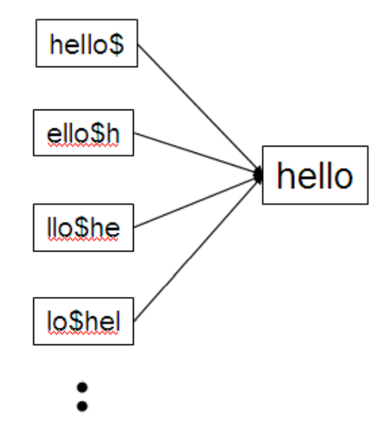
3.2.1 Permuterm indexes

Slide 8
3.2.1 Permuterm indexes
n$ma
man
Query: m*n
m*n$
n$m*
n$moro
moron
One disadvantage of the permuterm index is that its dictionary becomes quite large, including as it does all rotations of each term

Slide 9
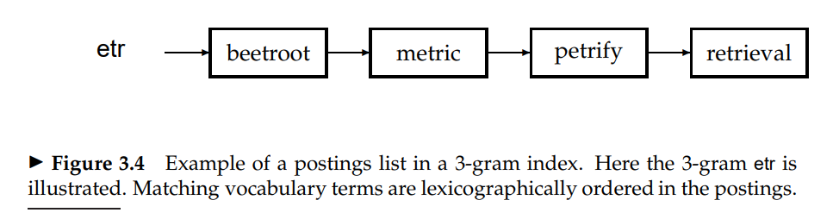
3.2.2 k-gram indexes for wildcard queries
castle
$ca, cas, ast, stl, tle, le$

Slide 10
3.2.2 k-gram indexes for wildcard queries
“$re”
Query: re*ve
“$re” and “ve$”
relive, remove, etc.
“ve$”

Slide 11
3.2.2 k-gram indexes for wildcard queries
“$re”
Query: red*
“$re” and “red”
retired(?)
“red”
postfiltering
retired(X)
A search engine may support such rich functionality, but most commonly, the capability is hidden behind an interface (say an “Advanced Query” interface) that most users never use.

Slide 12
3.3 Spelling correction
Of various alternative correct spellings for a mis-spelled query, choose the “nearest” one. This demands that we have a notion of nearness or proximity between a pair of queries.
For example, grunt and grant both seem equally plausible as corrections for grnt. Then, the algorithm should choose the more common of grunt and grant as the correction.

Slide 13
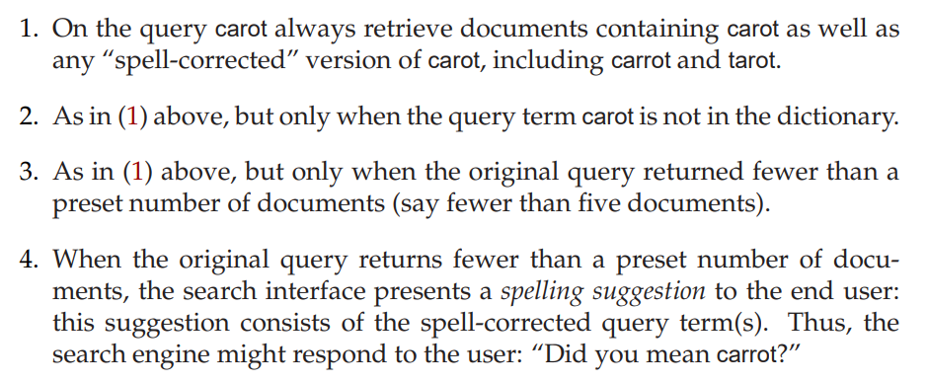
3.3 Spelling correction

Slide 14
3.3.3 Edit distance
Given two character strings s1 and s2, the edit distance between them is the minimum number of edit operations required to transform s1 into s2.
Insert a character into a string
Delete a character from a string
Replace a character of a string by another character
for these operations, edit distance is sometimes known as Levenshtein distance.
Example: the edit distance between cat and dog is 3.
Remark: A higher weight may be placed on replacing the character s by the character p, than on replacing it by the character a.

Slide 15
3.3.3 Edit distance
The obvious way of doing this is to compute the edit distance from q to each string in V.
The simplest such heuristic is to restrict the search to dictionary terms beginning with the same letter as the query string; the hope would be that spelling errors do not occur in the first character of the query. (Continued next page)

Slide 16
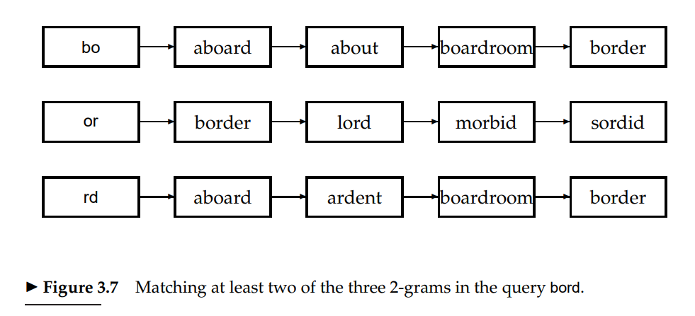
3.3.4 k-gram indexes for spelling correction

Slide 17
3.3.4 k-gram indexes for spelling correction
Query: bord
boardroom
Jaccard distance for bigram
bo
bo
We have 2/(8+3-2)
or
oa
This value is so small, so we reject boardroom.
rd
ar
…
om
Remark: Isolated-term correction would fail to correct typographical errors such as “I loves KAIST”.

Slide 18
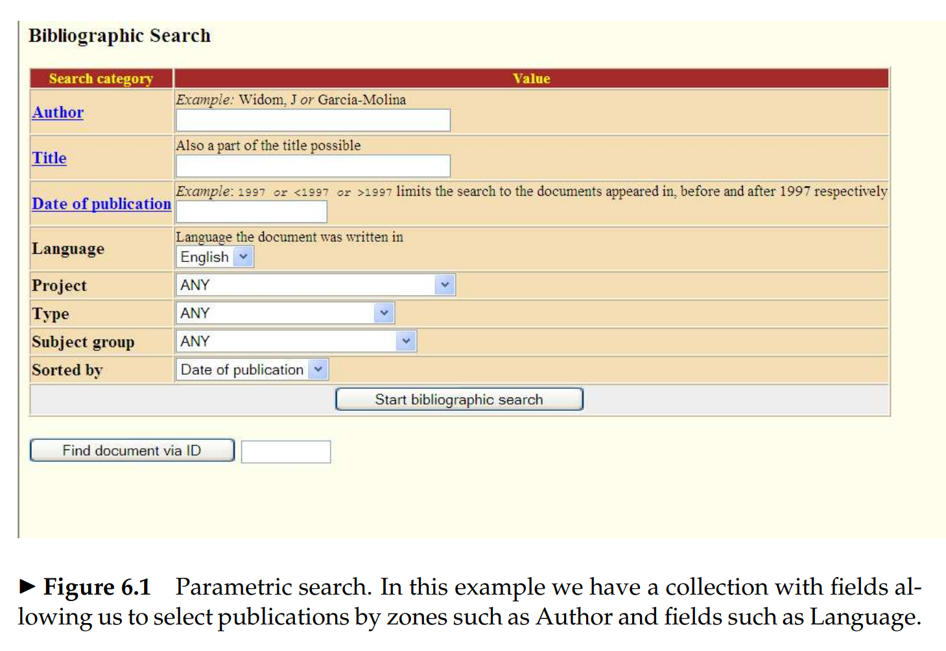
6.1 Parametric and zone indexes

Slide 19
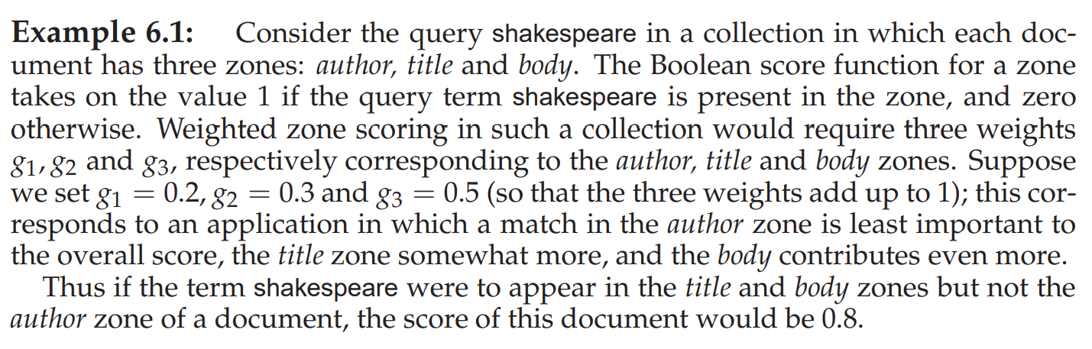
6.1.1 Weighted zone scoring

Slide 20
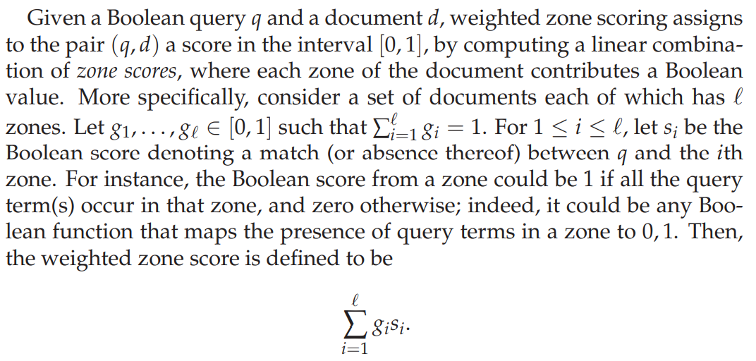
6.1.1 Weighted zone scoring

Slide 21
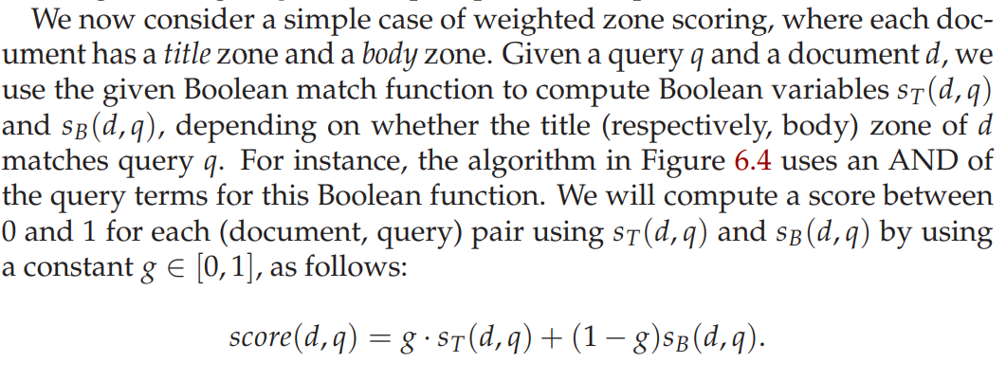

6.1.2 Learning weights

Slide 22

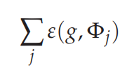
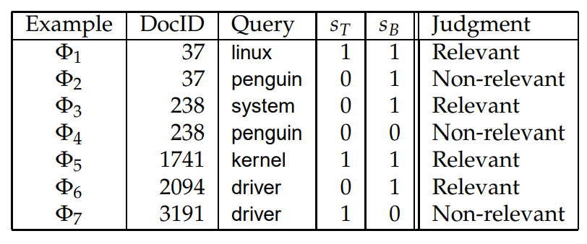
6.1.2 Learning weights

Slide 23
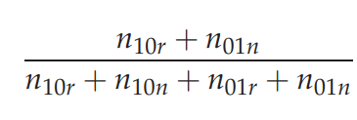
6.1.2 Learning weights
Picking the best value of g reduces to the problem of minimizing a quadratic function of g over the interval [0, 1].
Let $n_{01r}$ (respectively, $n_{01n}$ ) denote the number of training examples for which $S_{T}\left(d_{j},q_{j}\right)=0$ and $S_{B}\left(d_{j},q_{j}\right)=1$. Then the answer is

Slide 24
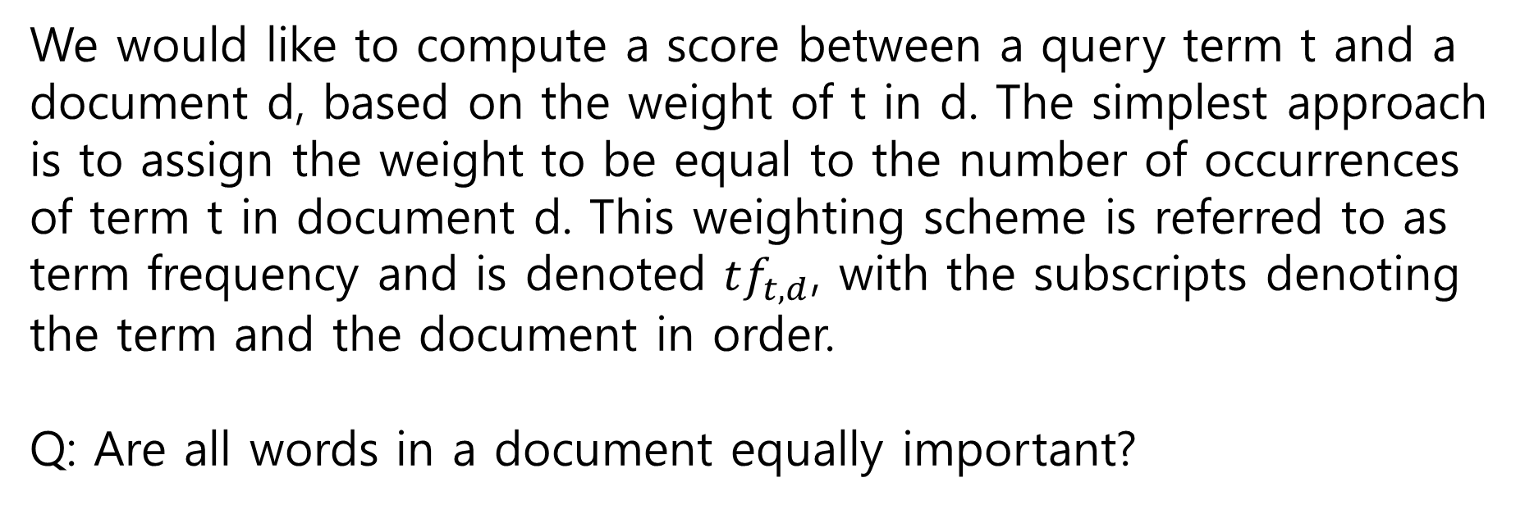
6.2 Term frequency and weighting
We would like to compute a score between a query term t and a document d, based on the weight of t in d. The simplest approach is to assign the weight to be equal to the number of occurrences of term t in document d. This weighting scheme is referred to as term frequency and is denoted $tf_{t,d}$, with the subscripts denoting the term and the document in order.
Q: Are all words in a document equally important?

Slide 25
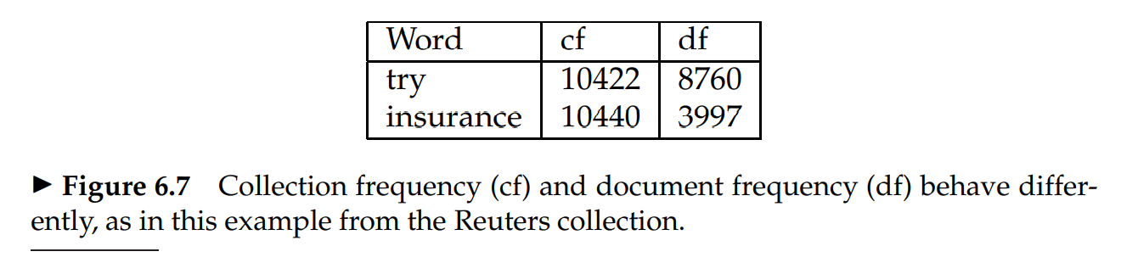
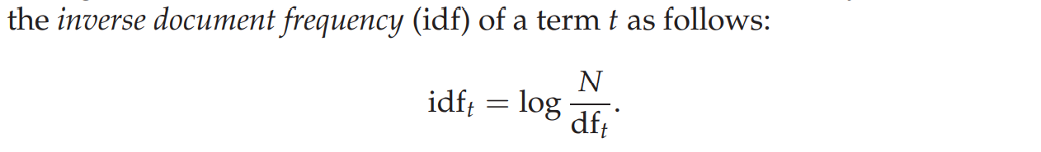
6.2.1 Inverse document frequency

Slide 26
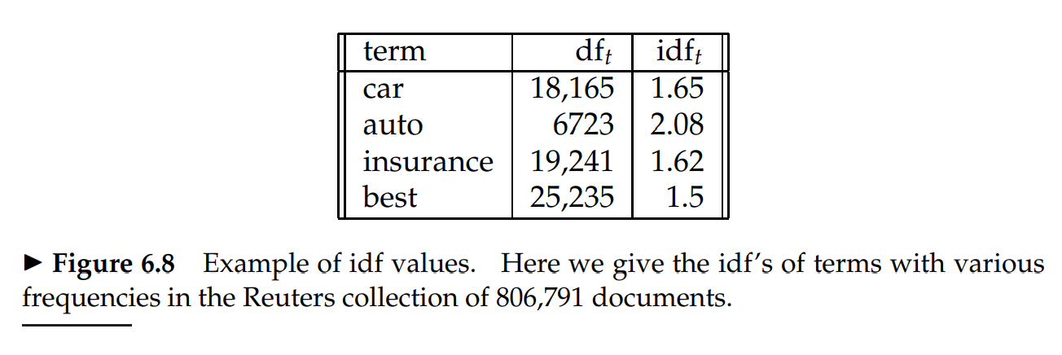
6.2.1 Inverse document frequency

Slide 27
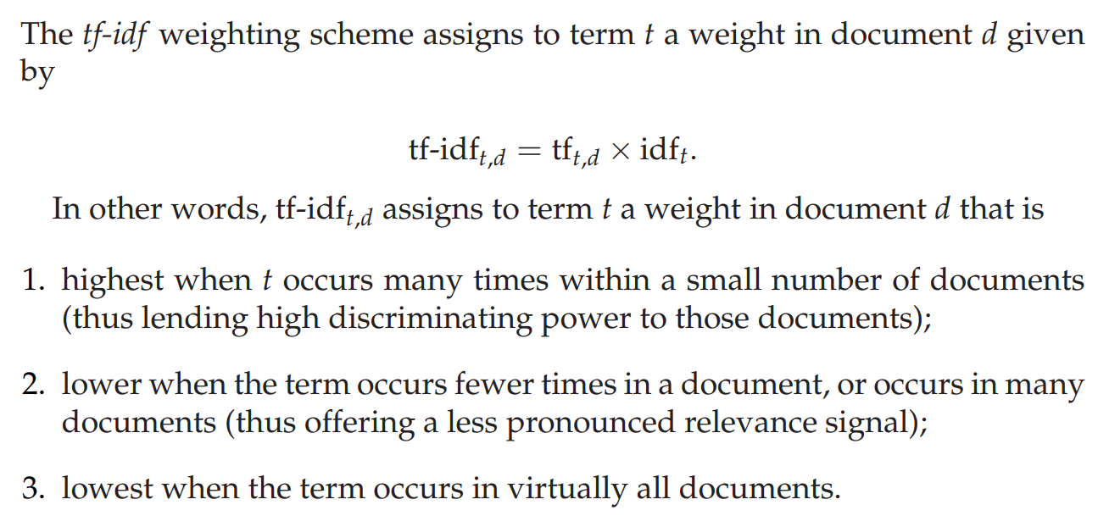
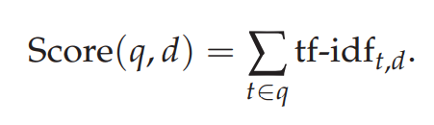
6.2.2 Tf-idf weighting

Slide 28
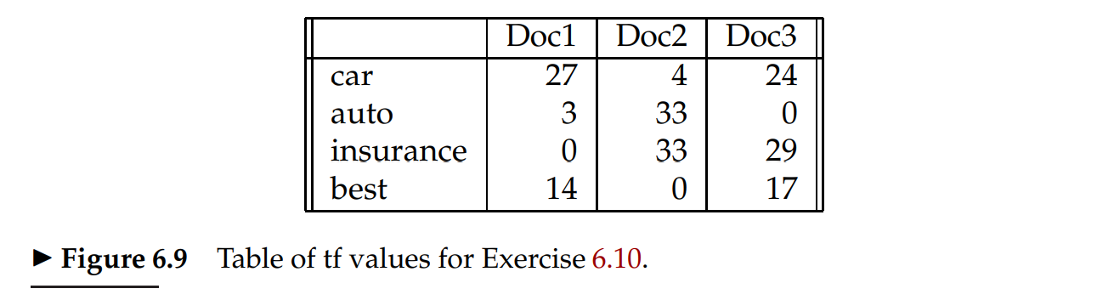
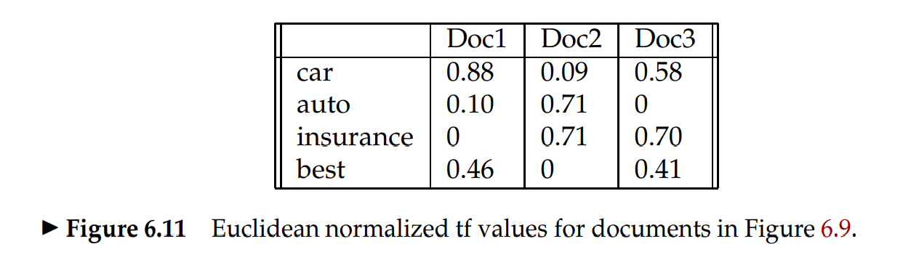
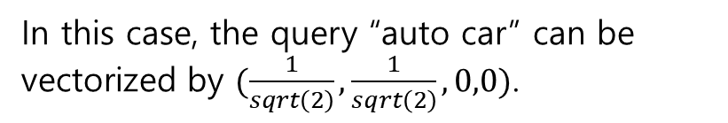
6.3 The vector space model for scoring
In this case, the query “auto car” can be vectorized by $(\frac{1}{sqrt\left(2\right)},\frac{1}{sqrt\left(2\right)},0,0)$.

Slide 29
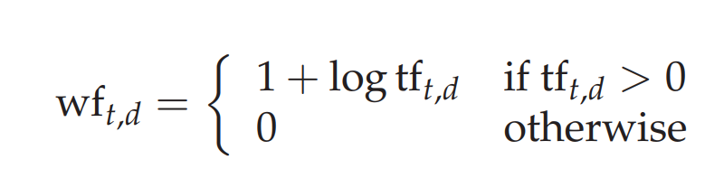

6.4 Variant tf-idf functions
It seems unlikely that twenty occurrences of a term in a document truly carry twenty times the significance of a single occurrence.

Slide 30
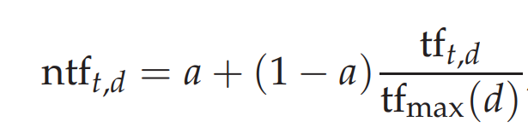
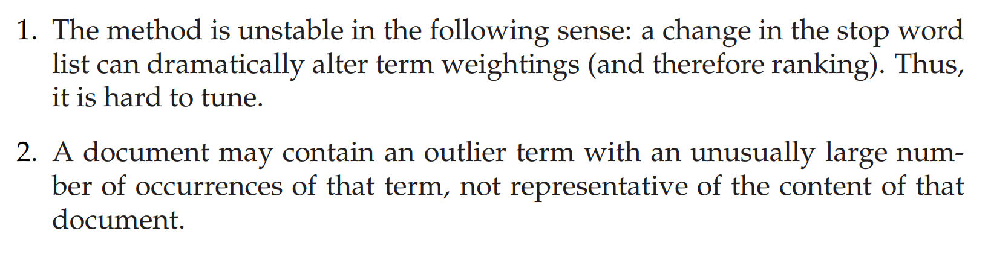
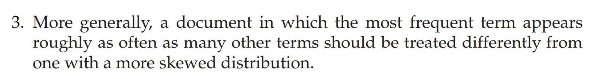
6.4.2 Maximum tf normalization

